Slide 1
CHIRP and ES2
Srikanth Rangarajan, SSIE

Slide 2
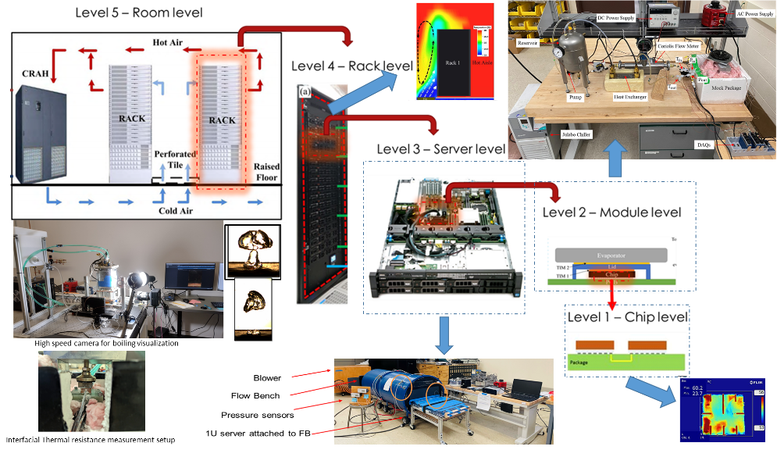
Research Facility: CHIRP and ES2

Slide 3



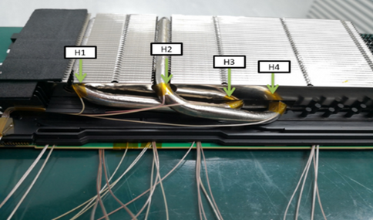
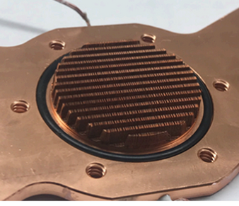






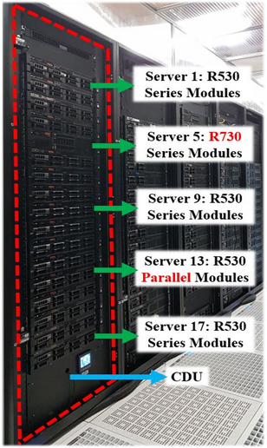
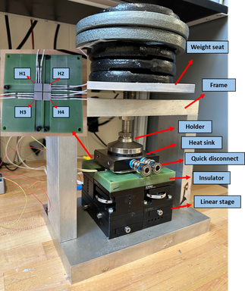


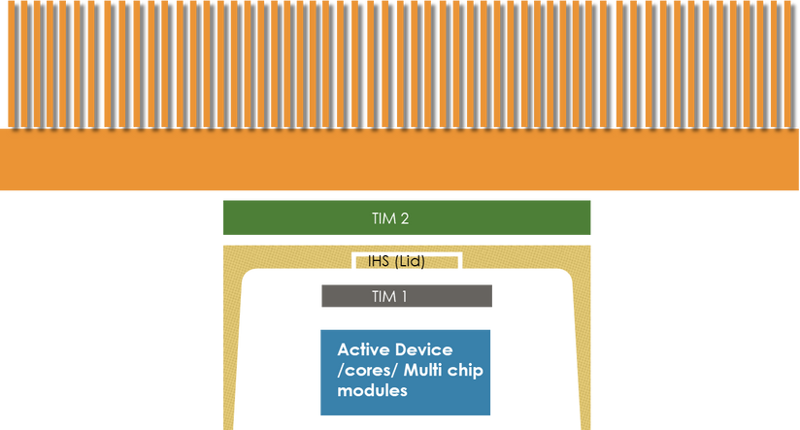




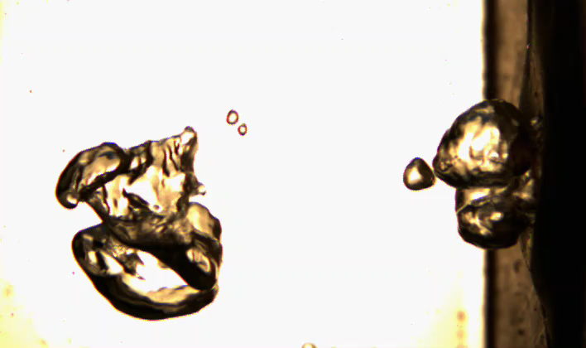
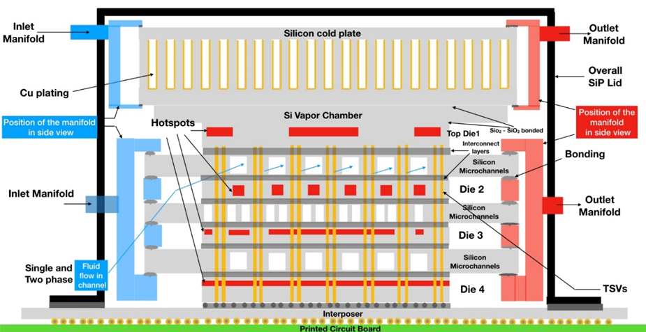


Two-phase cooling: Pumped flow
04
01
Air Cooling
Building compact models to optimize two phase cold plate design
Making Air cooling Energy Efficient using advance control systems and heat pipes
Energy Smart
Electronic Systems
Cooling
load
02
Single Phase Liquid
Cooling
Rack level
05
Single and two-phase liquid cooling in highly heterogenous rack environments
Design and optimization for Heterogenous Integration Packaging conditions
IT
workload
Chip level
06
Two-phase cooling: Immersion cooling
03
Embedded cooling with hybrid bonding to augment chip heat flux with increased reliability
Thermal aware floor planning
Leveraging deep learning techniques to predict the boiling heat flux and the heat transfer coefficient

Slide 4





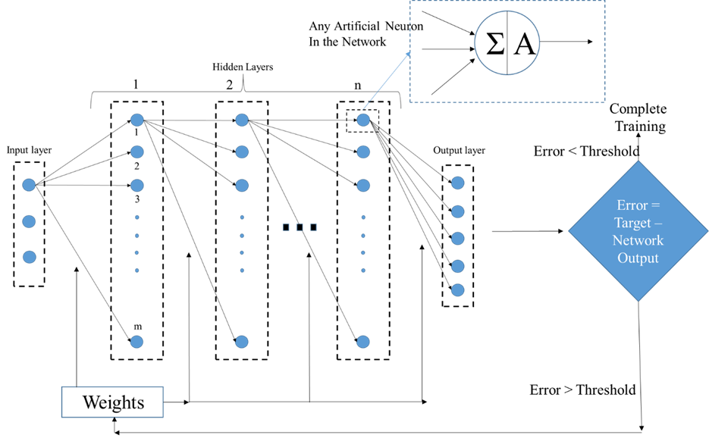










The Problem of heat
Accessibility (packaging)
Strategic Areas and Future Directions
Machine Learning based
Compact model for design, prediction and Control
of cooling performance
System Level Modeling
Sustainability
Reliability modeling in system level to increase lifetime of
the chip and cooling components
4
Integration of renewable
Energy storage
Two phase liquid
cooling
2
Experimental data
Acquisition and
AI based compact model
Fluid Selection
Integration of advanced
Thermal Interface Materials
Single phase liquid cooling
Air Cooling : Data center Predictive control
1
3
Experimental data
Acquisition and
AI based compact model
To optimize
cold plate design
Integration of passive
cooling solutions Heat pipe,
Vapor chambers, PCMs
Maximize Energy Efficiency
By predictive control
of air-cooling systems

Slide 5
Experimental facility and capabilities
The capabilities of the thermal management labs at Binghamton include a thermal lab in the Center of Excellence building, wherein several benchtop experiments and set up, a full-scale data center which has about 2500 square feet of raised floor, multi cold aisle, and 2 CRAH units and a high bay thermal lab which is used for multi rack air to air to liquid and liquid to liquid thermal management investigations. These capabilities allow researchers to conduct thermal management experimental studies ranging in scale from a single chip level to an entire data center scale. We are able to conduct detailed experimental studies on thermal management of electronic systems using:
Air cooling at the chip, server, rack, and data center levels
Indirect single- and two-phase liquid cooling
Immersion cooling
Sustainability and energy conservation
A schematic of the different levels at which thermal management studies are conducted are shown in the previous slide. These studies are typically coupled to analytical investigations to create predictive, verified models. The models are used for design optimization using Neural Networks and machine learning approaches.
These approaches are used to optimize thermal management approaches that are already commercialized as well as coming up with new innovative solutions that enable future generations of electronic systems

Slide 6
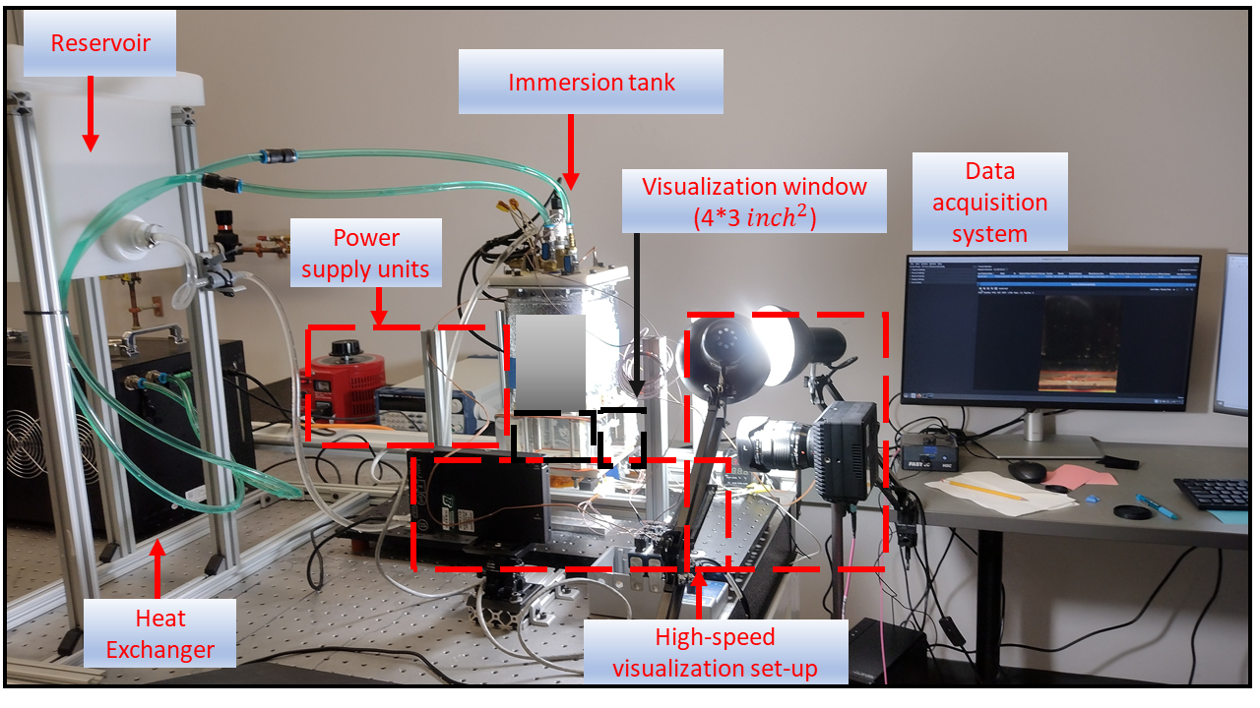
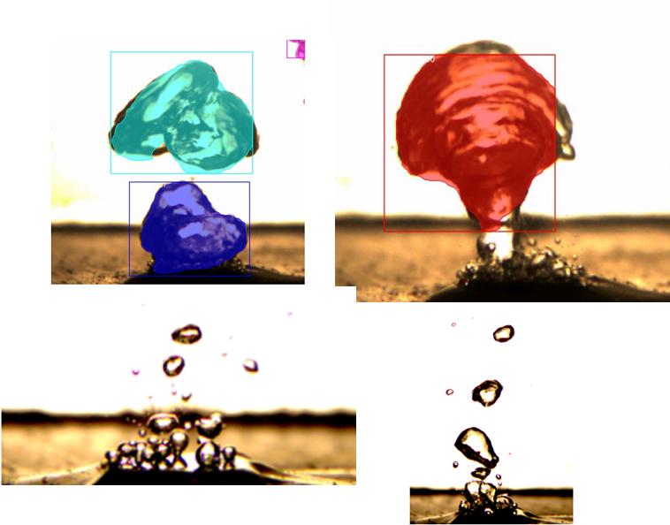
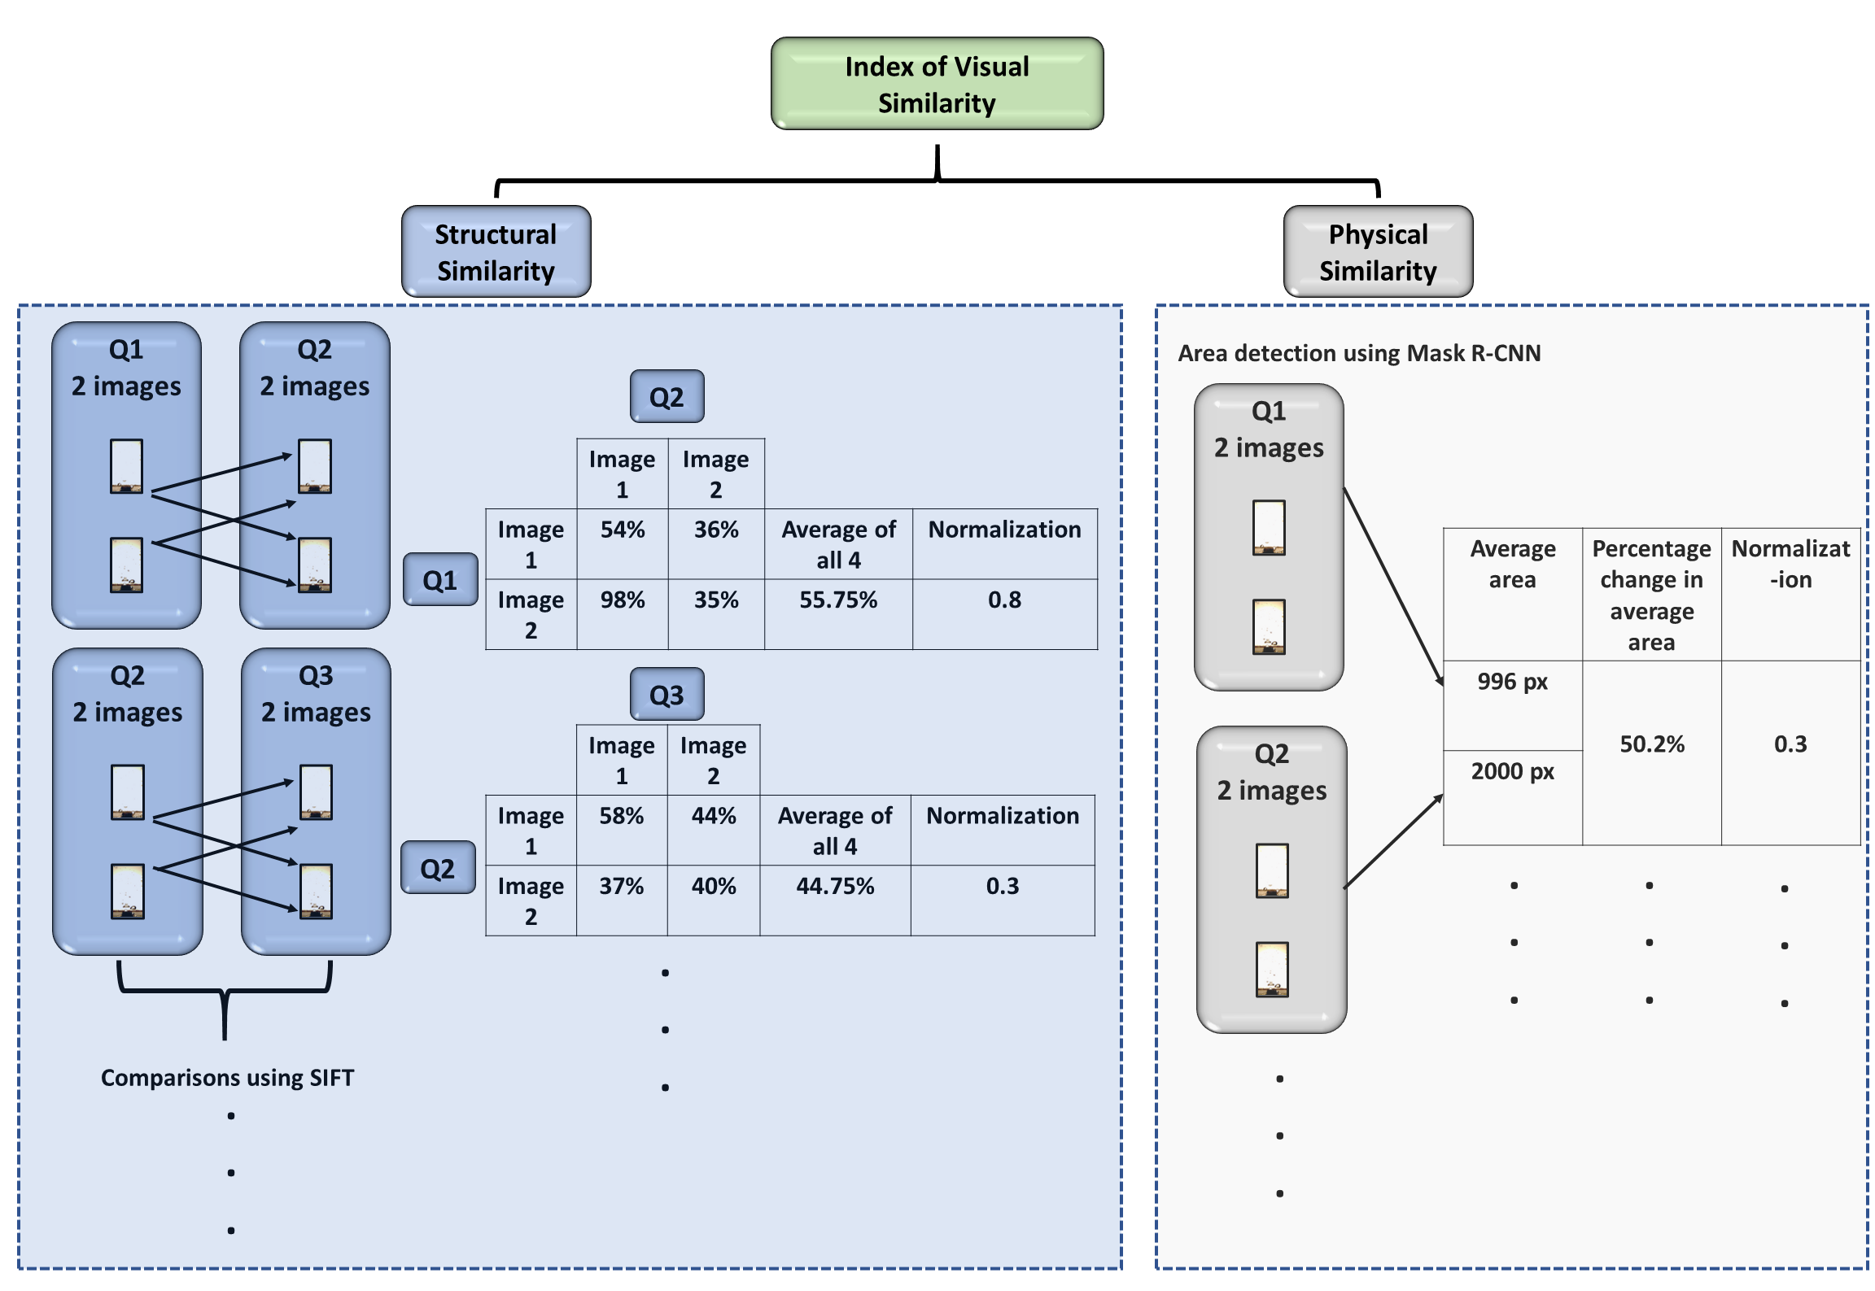
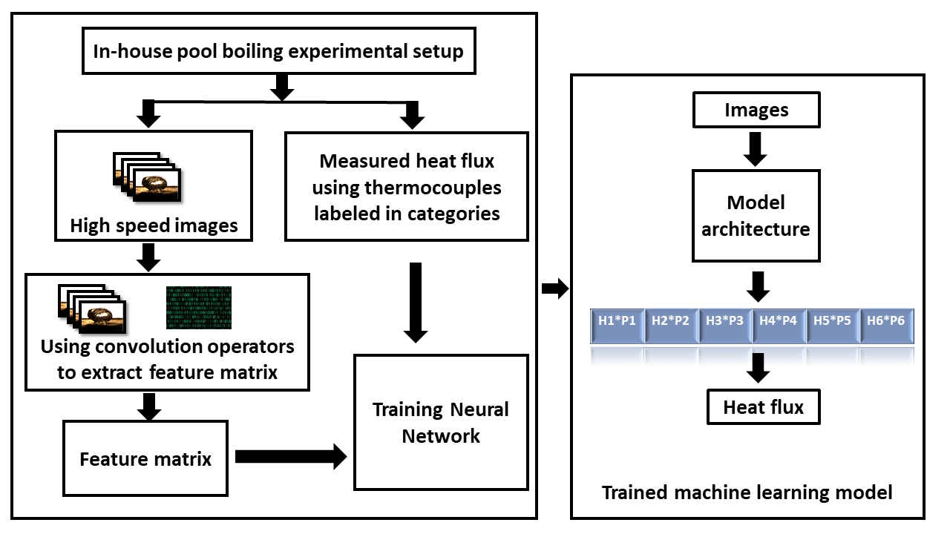
CHIRP: Deep Learning based Predictive model for boiling process
Beyond the meta-data analysis, it is imperative to extract
physically meaningful features from visual data
Optimization of data input to training process as a
function of measurement uncertainty plays a crucial role
Notes:
Slide 3: AI in Action – demo, images, etc.
Tell your story using a pictures, images, charts, graphics, demo, etc. (Note: videos may not work & may take time away from you, embedded videos may work; we will test)

Slide 7
Modeling capabilities
Our existing capabilities to model and predict the heat transfer performance of complex phenomena occurring in the data center include using Deep learning-based Artificial Neural networks (ANNs) and Convolutional Neural Networks (CNNs).
There have been many studies for developing empirical correlations to predict the heat transfer coefficient and critical heat flux for highly complex non-linear flow and heat transfer problems. Still, these correlations show poor predictive accuracy in the outranged data of their geometrical or operational conditions.
Furthermore, conventional regression models are not powerful enough to capture the microchannel's geometrical and fluid flow complexities.
Therefore, we adopted widely used deep learning-based ANNs and CNNs to model complex interdependent parameters. Training our ANN and CNN model with our carefully constructed dataset allows for an accurate prediction of single and two-phase thermos hydraulic performance and the heat flux. The ANN is also used to arrive at global optimal design for cooling solutions ranging from the data center to the chip level thus increasing energy efficiency.

